Slide 1
User Experience

Slide 6
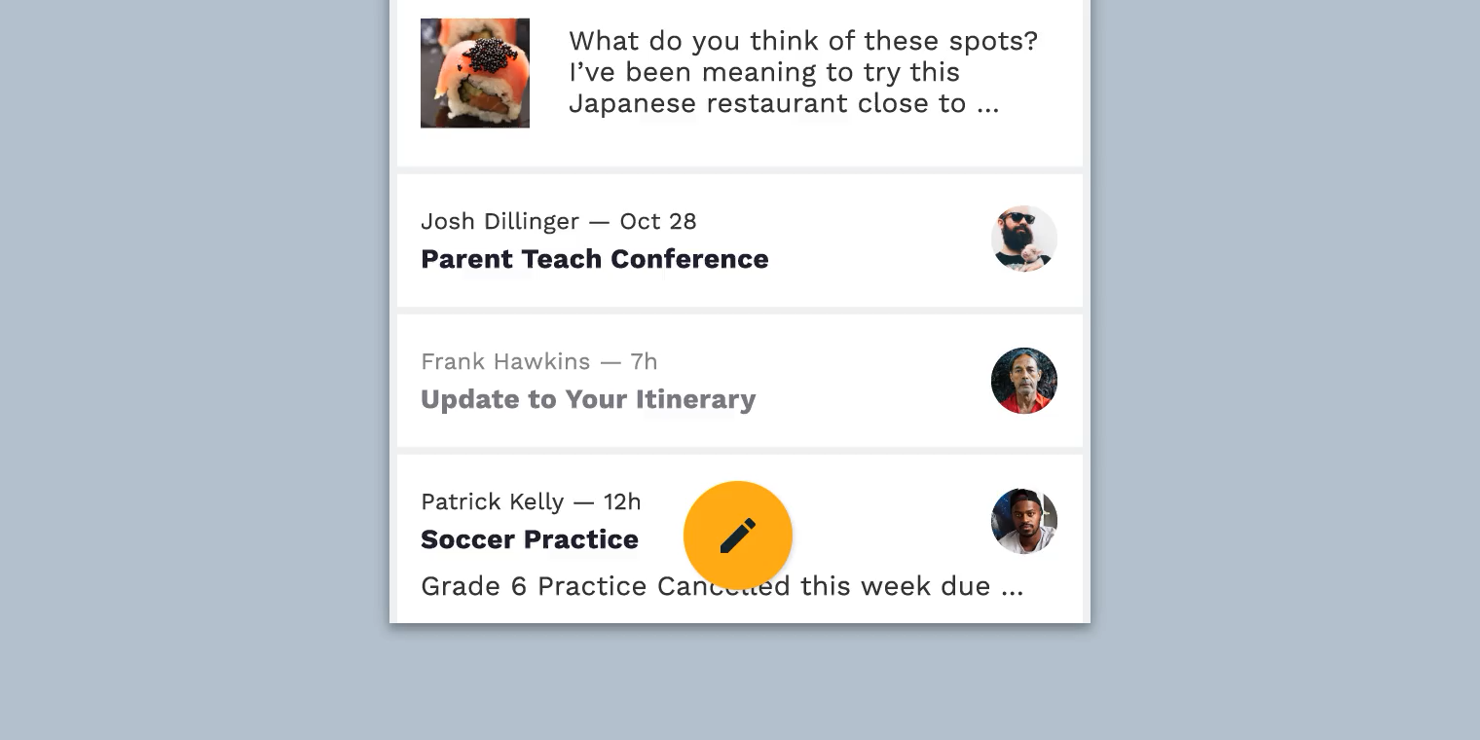

Slide 7
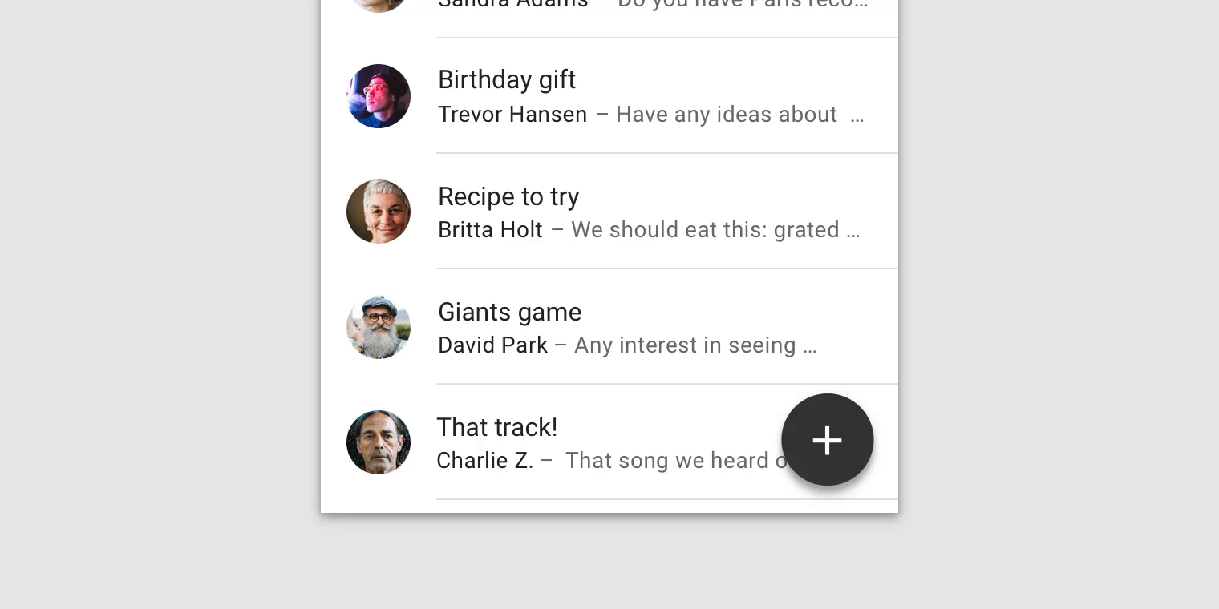


Slide 11
UX in Android

Slide 12
UX in Android
Drawables

Slide 13
UX in Android
Drawables
Styles

Slide 14
UX in Android
Drawables
Styles
Theme

Slide 15
User Experience
Drawables
Styles
Themes

Slide 16
User Experience
Drawables
Styles
Themes

Slide 17
Drawables
Styles
Themes

Slide 18
Performance
Accuracy
Responsiveness

Slide 19
Faster
Reduce code

Slide 20
Drawable is generic class used to present any kind of graphic
res/drawable project folder

Slide 21
Bitmap file (png. Jpeg)
Shape drawable
Layer List
Vector drawable
Transition drawable

Slide 22
Bitmap files are a set of pixels in a grid
Vector graphics are describing the objects geometrically. (this means vector can scale with no loss of quality

Slide 23
Image asset Studio
Helps you to build multiple versions of each bitmap for different disparate resolutions.
Create your own app icon

Slide 24
Vector asset Studio
Create one image in xml and it will be able to scale for all different devices.
Create your own app icon

Slide 25
Performance
Use smallest resolution
Resize, crop, compress
Vector drawings for simple images
Use Lib: Glide or Picasso
Use lossy image formats and adjust quality where possible

Slide 26
Performance
Image downloading and caching library for Android (glide, Picasso)

Slide 27
Style
Specify the look and feel of individual views in android
Why?
Reduce duplication
Make code more compact
Manage visual appearance of many components with one style.
Inherit and expand of a parent style

Slide 28
Theme
Is a style which applied to an entire activity or even entire application
Applied in the Android Manifest
There are few Android templates “AppTheme”
High-density pixles
Px = dp * (dpi / 160)

Slide 29

Layer List example

Slide 30
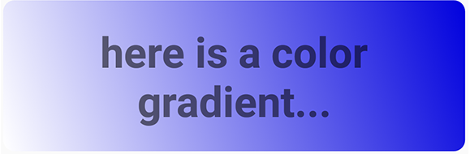
GradientDrawable example

Slide 31
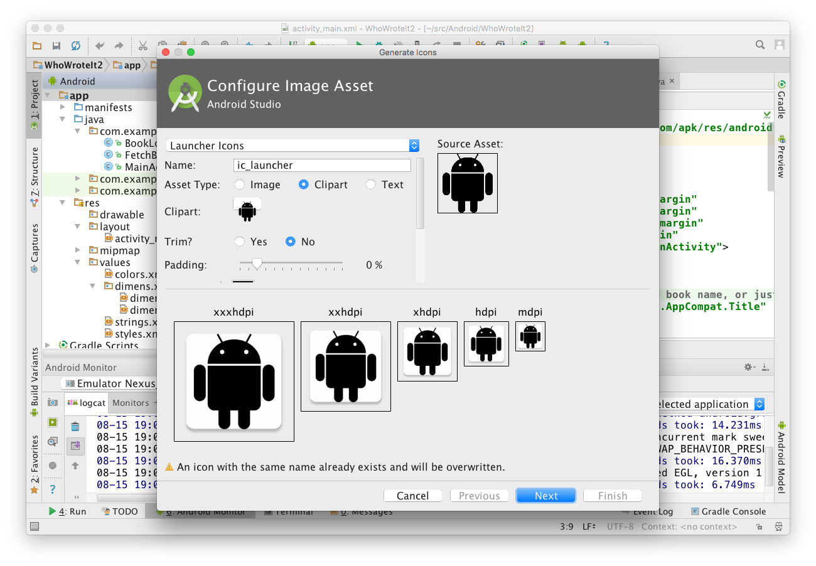
Chose icon typeand change name
Choose Image, Clipart, or Text
Click icon to chose clipart
Inspect assets for multiple screen sizes

Slide 32
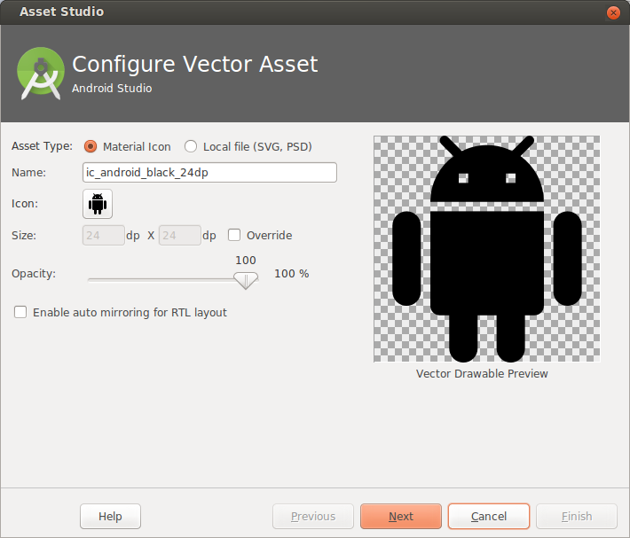
Choose from Material Icon library, or supply your own SVG or PSD vector drawing
Opens Material Icon library

Slide 33
What is a Style?
Collection of attributes that define the visual appearance of a View
Reduce duplication
Make code more compact
Manage visual appearance of many components with one style

Slide 34
<TextView
android:layout_width="match_parent"
android:layout_height="wrap_content"
android:textColor="#00FF00"
android:typeface="monospace"
android:text="@string/hello" />
<TextView
style="@style/CodeFont"
android:text="@string/hello" />

Slide 35
styles.xml is in res/values
<resources>
<style name="CodeFont">
<item name="android:textColor">#00FF00</item>
<item name="android:typeface">monospace</item>
</style>
</resources>

Slide 36
Define a parent style...
<resources>
<style name="CodeFont">
<item name="android:layout_width">match_parent</item>
<item name="android:layout_height">wrap_content</item>
<item name="android:textColor">#00FF00</item>
<item name="android:typeface">monospace</item>
</style>
</resources>

Slide 37
Define child with Codefont as parent
<resources>
<style name="RedCode" parent="@style/Codefont>
<item name="android:textColor">#FF0000</item>
</style>
</resources>

Slide 38
Theme
A Theme is a style applied to an entire activity or even the entire application
Themes are applied in AndroidManifest.xml
<application android:theme="@style/AppTheme">

Slide 39
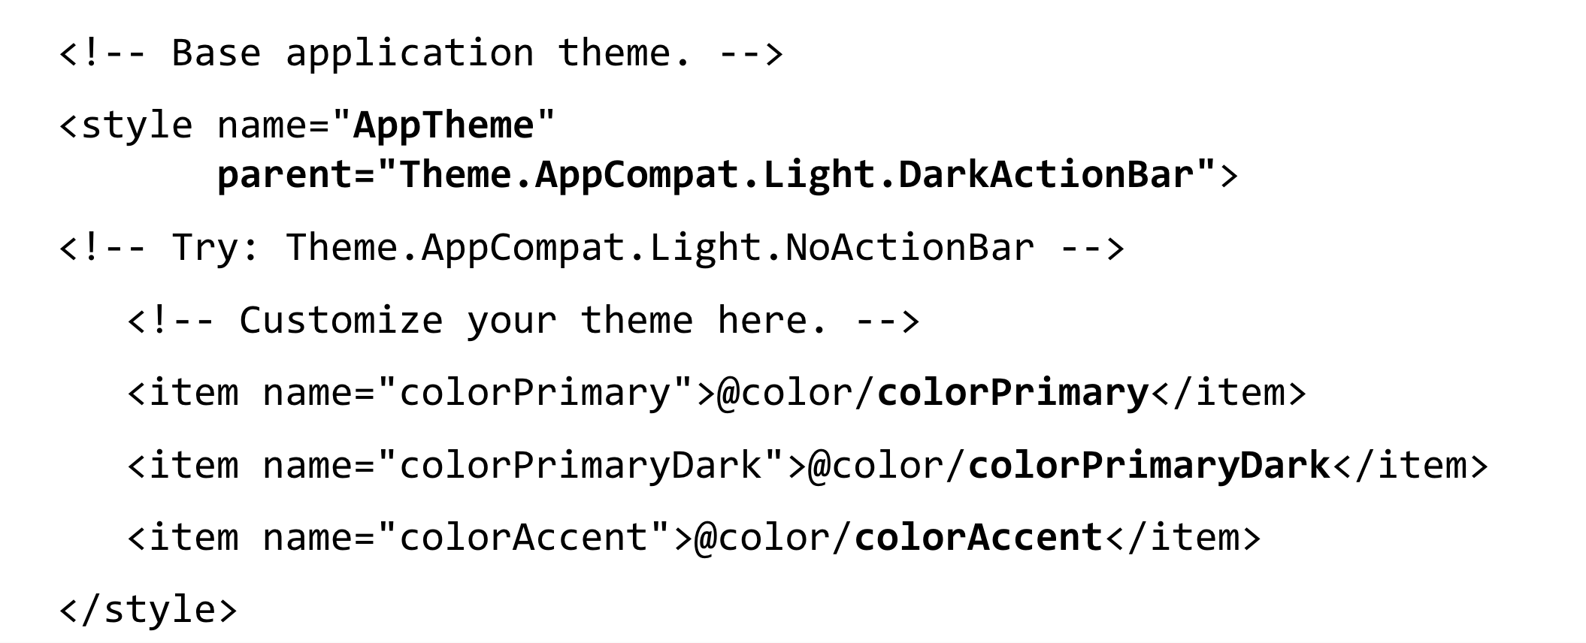
Customize AppTheme of Your Project

